Slide 1
Econ 210a: Technology and Organization in the Very Long Run
(January 29, 2020a)
J. Bradford DeLong
Spring 2019
Evans 648
W 1:10-3:00 pm
<https://bcourses.berkeley.edu/courses/1487686/>
<https://github.com/braddelong/public-files/blob/master/econ-210a-lecture-2a.pptx>

Slide 2
Technology and Organization in the Very Long Run: Readings for January 29…
Moses Finley (1965): Technical Innovation and Economic Progress in the Ancient World <http://www.jstor.org/stable/2591872>
Michael Kremer (1993): Population Growth and Technological Change: One Million B.C. to 1990 <http://www.jstor.org/stable/2118405>
Charles Jones (1995): R&D-Based Models of Economic Growth <https://delong.typepad.com/files/jones-r--d.pdf>

Slide 3
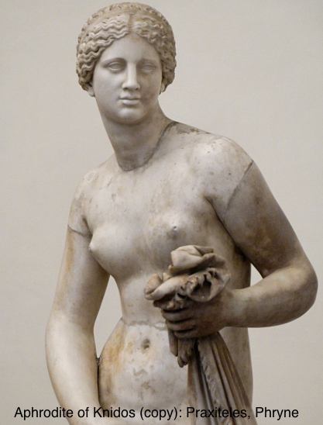

Introduction: “Ancient” Ain’t “Primitive” or “Unsophisticated”, Is It?
Could we teach:
Themistokles or Augustus much about politics?
Homer much about writing poetry?
Gaius Julius Caesar or Leonidas much about generalship?
Sophokles much about drama?
Phryne much about presentation-of-self-as-celebrity?
Michelangelo di Lodovico Buonarroti Simon much about painting ceilings?
Praxiteles much about sculpture?
Johann Sebastian Bach much about music?

Slide 4
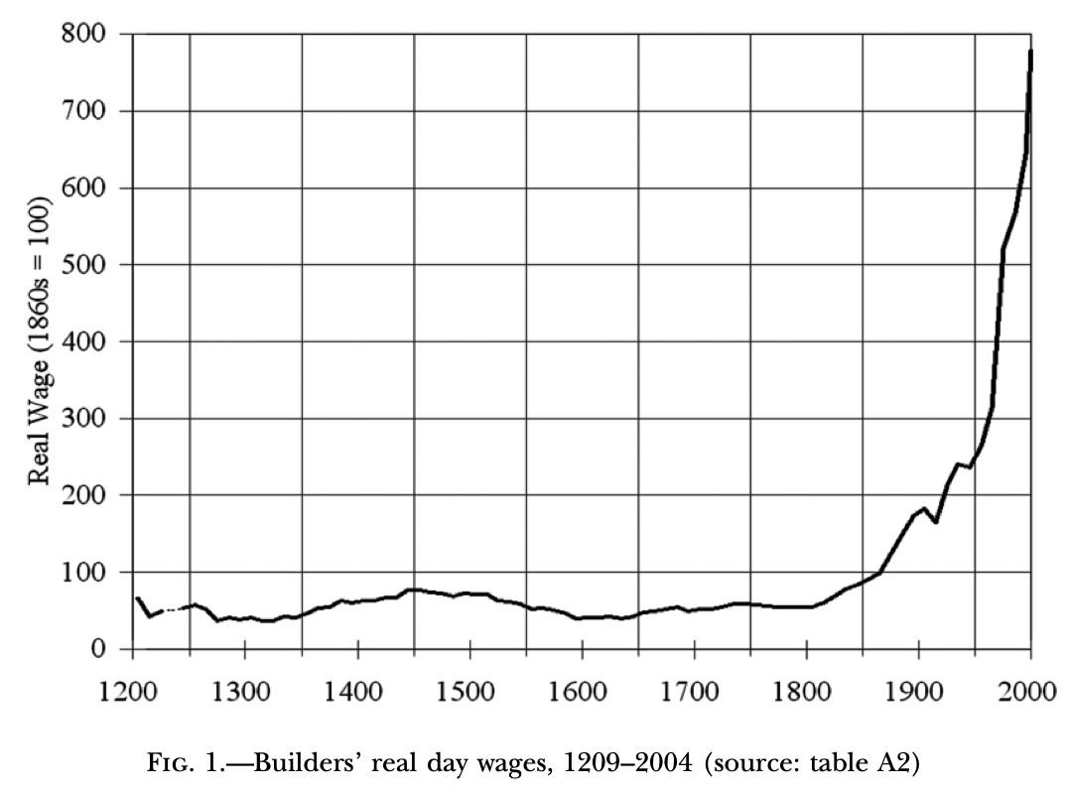
And Yet, If We Look at the Economy…

Slide 5
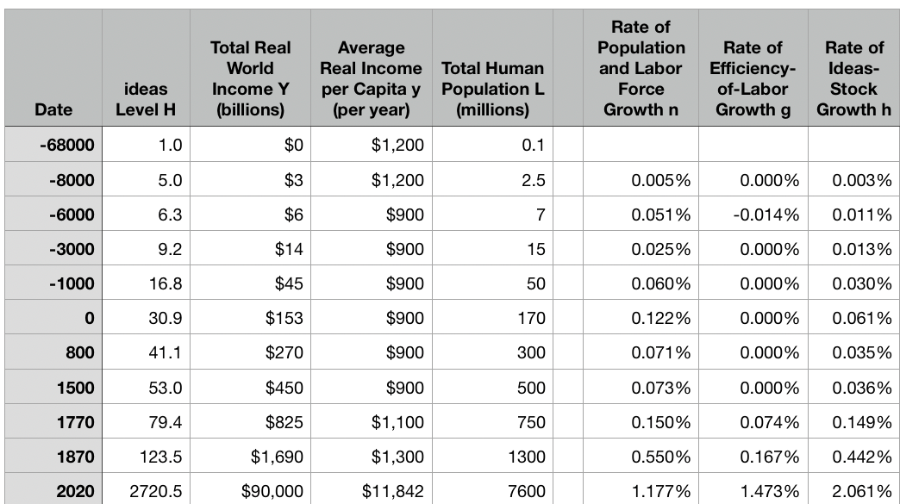
One Table: Average Global Numbers

Slide 6
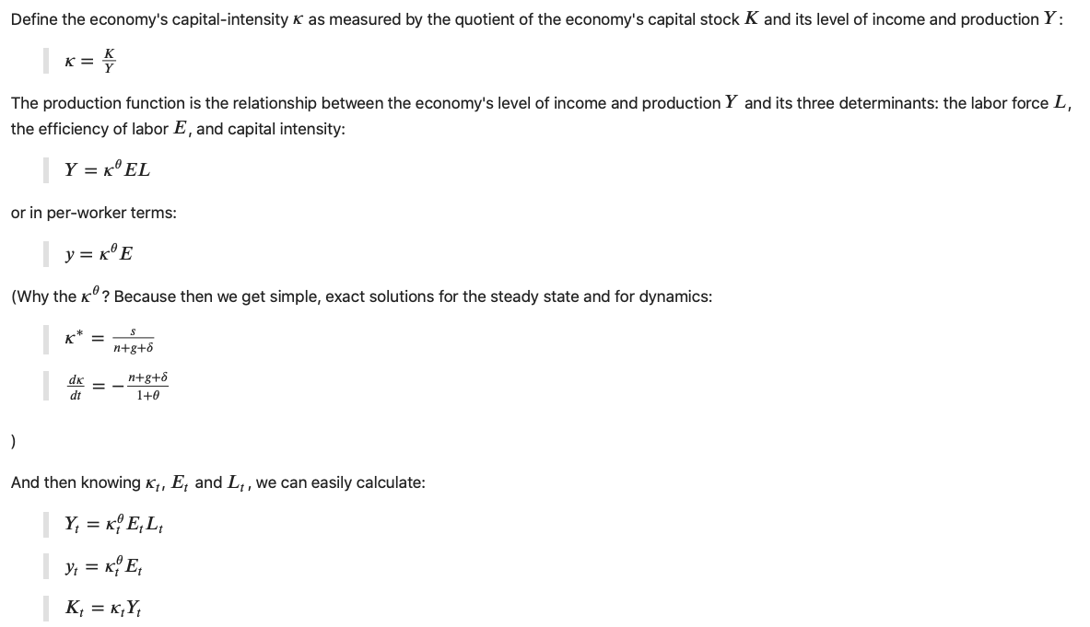
Solow Growth Theory

Slide 7
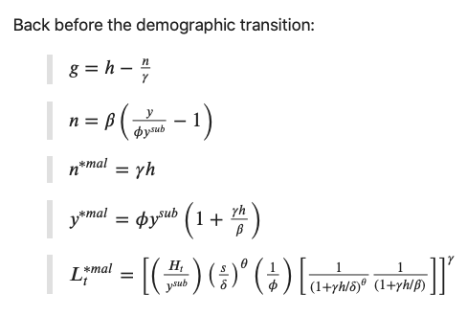
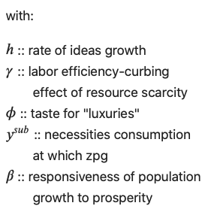

Solow-Malthus Growth Theory
Isaiah 13:
“The burden of Babylon, which Isaiah the son of Amoz did see…. Babylon, the glory of kingdoms, the beauty of the Chaldees' excellency, shall be as when God overthrew Sodom and Gomorrah. It shall never be inhabited, neither shall it be dwelt in from generation to generation: neither shall the Arabian pitch tent there; neither shall the shepherds make their fold there. But wild beasts of the desert shall lie there; and their houses shall be full of doleful creatures; and owls shall dwell there, and satyrs shall dance there. And the wild beasts of the islands shall cry in their desolate houses, and dragons in their pleasant palaces: and her time is near to come, and her days shall not be prolonged…”

Slide 8

h = 0.013, 0.030, 0.061, 0.035, 0.036%/Year
Is this something to be explained?
Yes, we have civilizational “efflorescences”…
But then we also have declines…
Current estimates of Mayan population in 700: 22 million
Population of Maya range today: 5 million
Roman empire 25% urban…
France crosses 25% urban in the 1700s
Rome, Constantinople, Alexandria, Antioch, all bigger at their peak than Paris was in any year before 1630…
It’s s and φ and perhaps y^{sub}, not h, that produce “economic booms” in pre-industrial populations and living standards

Slide 9

The Default State? How Was It Exited?
Malthusian Agrarianism—near-stagnation—as the default state of post-Neolithic humanity?
Exit:
Industrial Revolution
Modern Economic Growth
Reentry?
Astronomy and the Fermi Paradox: The Great Filter
Notes?

Slide 10
Reading Finley: Why Was h so Low?
Moses Finley (1965): Technical Innovation and Economic Progress in the Ancient World <http://www.jstor.org/stable/2591872>
Moses Finley definitely believes that there is an important puzzle here:
“The Greeks and Romans together added little to the world’s store of technical knowledge and equipment…”
“The Greeks and Romans built a high civilization, full of power and intellect and beauty, but they transmitted to their successors few new inventions…”
“There was both more and less technical progress in the ancient world than the standard picture reveals. There was more, provided we avoid the mistake of hunting solely for great radical inventions and we also look at developments within the limits of the traditional techniques…”
“The gear and the screw, the rotary mill and the water-mill, the direct screw-press, glass-blowing and concrete, hollow bronze-casting, the dioptra for surveying, the torsion catapult, the water-clock and water organ, automata (mechanical toys) driven by water and wind and steam—this short list is fairly exhaustive, and it adds up to not very much for a great civilization over fifteen hundred years…”

Slide 11
What Does Finley Have to Say?
Assertions about responsiveness to fashion and imperatives of craftsmanship…
Lots of incremental improvements
Little wide dissemination
“Intellectually (or scientifically) speaking, there was a basis for more technological advance—in production—than was actually made…”
“Archimedes' practical inventions, I hasten to add, were military and were made only under the extraordinary and irresistible stimulus of the siege of his native Syracuse by the Romans.”
“it is this unanimity which justifies the argument from silence…”

Slide 12
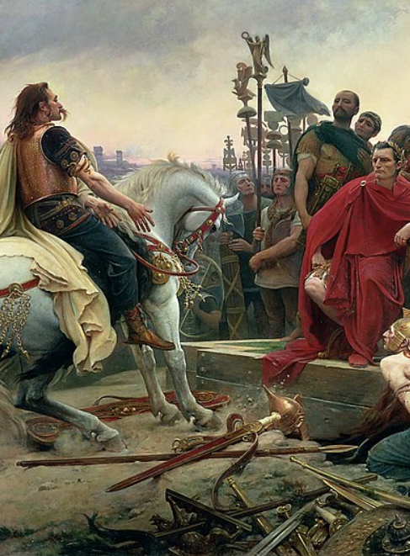
What Does Finley Have to Say? II
“Why did neither the Ptolemies nor the Sicilian tyrants nor the Roman emperors systematically (or even spasmodically) turn their engineers to the search for higher productivity, at least in those sectors of the economy which produced the royal revenues?
“Whatever the answer, it was not lack of capital (or lack of authority). Funds, manpower and technical skills were made available (and wasted) in vast and ever increasing amounts for roads, public buildings, water supply, drainage and other amenities, but not for production.
“Of course, the effort to increase productivity might have proved unsuccessful - but it was never even attempted…”

Slide 13

Questions for Finley
What are your sources? And why did you choose those sources?
Do you trust your sources? What would you learn about today’s societies from today’s analogues to your sources?
So what is your explanation? Why wasn’t h bigger back in pre-industrial times?
Why is your explanation stable against perturbations? What, in your view, happens if a growing number of people do decide to focus on increasing h?
How did this pattern you identify develop?
Why did this pattern you identify come to an end?
Does it generalize to other civilizations than the one you know so well?

Slide 14
Reading Kremer: Is “Two Heads Are Better than One” a Sufficient Explanation?
Michael Kremer (1993): Population Growth and Technological Change: One Million B.C. to 1990 <http://www.jstor.org/stable/2118405> < http://tinyurl.com/dl2017201e>
One simple assumption and its inexorable consequences:
Two heads are better than one—humans as anthology intelligence
Malthusian population dynamics—but with a demographic transition escape possible
Demographic transition depends not on culture but on wealth
Conclusion: the agrarian-age “gunpowder empire” or previous not the natural climax state of the human race
Rather, an industrial revolution and then modern economic growth inevitable: baked in the cake

Slide 15
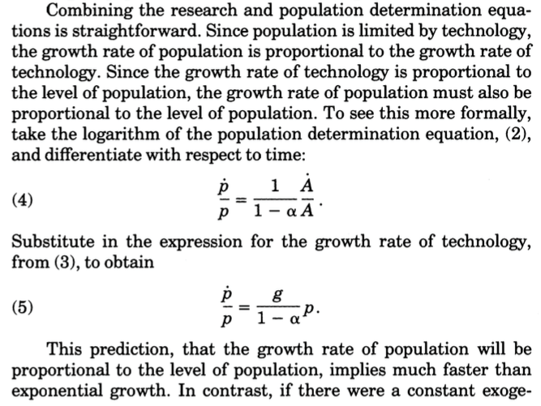
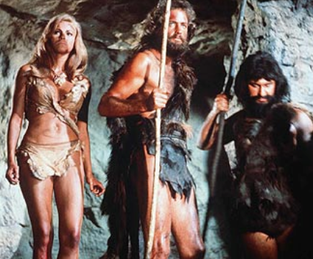
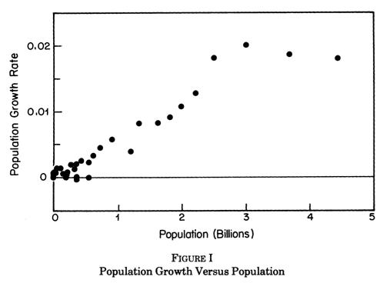
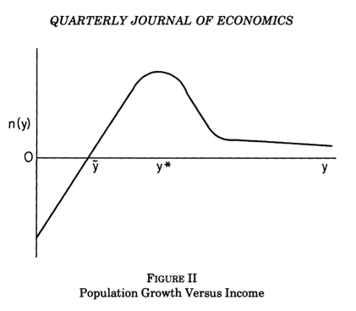
1,000,000 BC

Slide 16
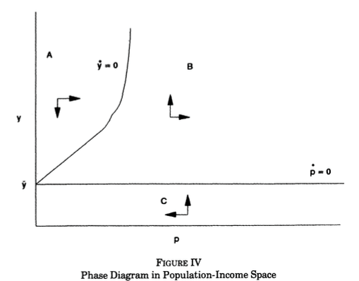
Michael Kremer: Two Heads Are Better than One, Plus Demographic Transition Gives Us This Phase Diagram
Kremer’s model generates very strong conclusions:
Eventual modern economic growth inevitable, and inescapable
Major determinants of when MEG takes hold:
improvements in communication-diffusion,
in science-innovation, and
in the triggers of the demographic transition
The conclusions are strong, but only as strong as the model. How strong is the model?
What other state variables should be in there?

Slide 17

Questions for Kremer
Where does your model break down? Doesn’t it imply a true singularity—in the relatively near future: dp/dt = kp² is a truly fearsome beast…
In fact, why isn’t economic growth now significantly faster worldwide than it was 1870-1900?
Maybe you can talk about “leading edge societies”—but even there your logic breaks down after 1973, doesn’t it?
Why don’t whatever factors break your logic after 1973 break it, or at least have the potential to break it, back at any time in the past?
Suppose you wanted to say that there were complications—that technological progress was proportional to the effective STEM workforce—how would you model the determinants of Lstem?

Slide 18
Reading Jones: Is “Two Heads Are Better than One” a Sufficient Explanation?
Charles Jones (1995): R&D-Based Models of Economic Growth <https:// delong.typepad.com/files/jones-r--d.pdf>
The near-constancy of growth since 1870 (or, perhaps, 1945) strongly suggests we need models that converge to some form of stable steady-state balanced-growth path:
“Effective stem labor force…”
“Uh-oh: we picked the low-hanging fruit…”

Slide 19
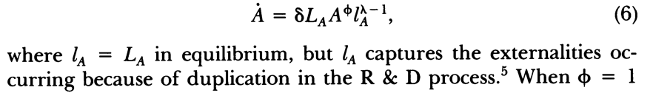
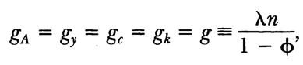
The Master Equation
What is going on here?
When the growth rate of A is g, invention is becoming harder over time by a factor…
And when that is the case, the resources that can be effectively devoted to invention (the “effective stem labor force”) is growing at rate what?
Convergence to equilibrium?

Slide 20

Questions for Jones
Do you believe your transition dynamics here?
Where do your λ and φ come from? What could and does cause them to shift?
You write that “the monopoly effect in the model is large and dominates the negative externalities” from the “large negative externalities in the R&D process (both at a point in time and across time)” that arise from λ, φ < 1. Hence the decentralized economy underinvests in R&D even though each invention is permanently patented. But a better model would have A from both R&D and from learning-by-doing, wouldn’t it?
Could you use plausible determinants of shifts in λ and φ in this model to understand the large-scale structure of human history?

Slide 21
Catch Our Breath…
Ask a couple of questions?
Make a couple of comments?
Any more readings to recommend?

Slide 22
Notes…
Humans as an Anthology Intelligence <https://www.icloud.com/keynote/0mXqcK7TUGGJGZdud0ODZJjSg>

